Slide 1
The TINY sample language and it’s scanner

Slide 2
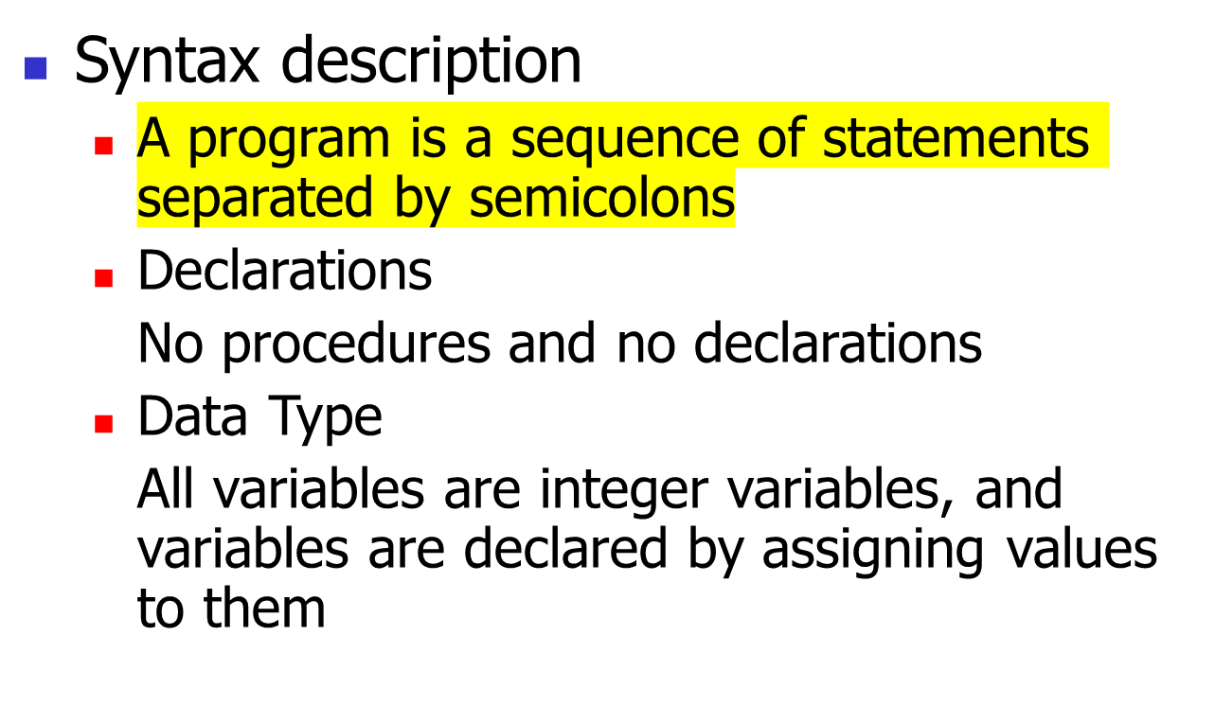
1.1 The TINY Language

Slide 3
  Statement
  Two control statements: if-statement and repeat-statement, read and write statements
  Expression
  Boolean and integer arithmetic expressions
  Comment
  Comments are allowed within curly bracket

Slide 4
Example
{sample program in TINY language- computes factorial}
read x; { input an integer }
if 0<x then { don’t compute if x<=0 }
fact:=1;
repeat
fact := fact*x;
x := x-1;
until x=0;
write fact; {output factorial of x}
end

Slide 5
2. Implementation of a TINY Scanner

Slide 6
2.1 Implementing a Scanner for the Sample Language TINY
The lexical structure of TINY
Reserved Words | Special Symbols | Other
if then else end repeat until read write | + - * / = < ( ) ; := | number identifier

Slide 7
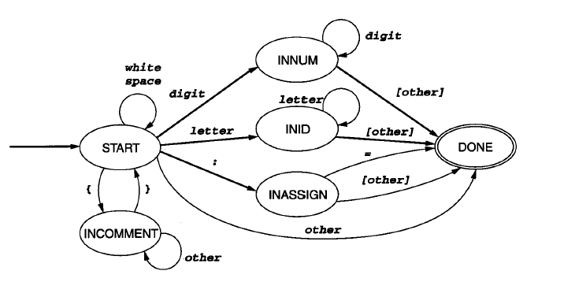
Construct a DFA for the scanner directly

Slide 8
Explanation:
All accepting states are collected into one state “DONE”, the different token recognized is saved in a variable
Construct a table of reserved words, reserved words are considered only after an identifier has been recognized, and then to look up the identifier in the table
The implementation of the DFA uses the doubly nested case analysis

